Slide 1

SALES ANALYSIS

Slide 2
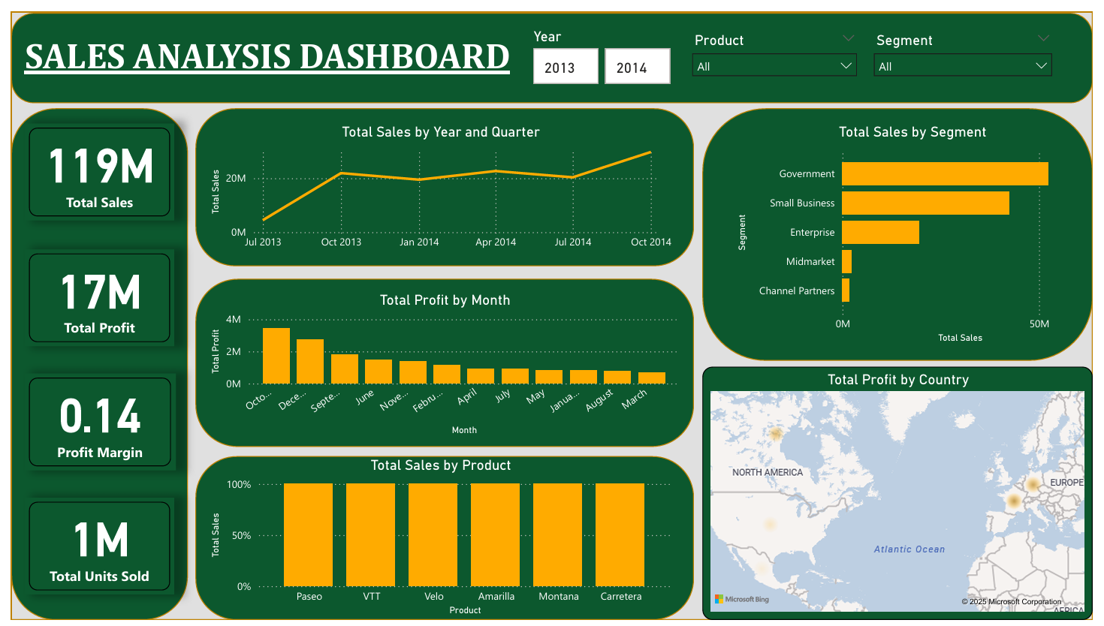

Slide 3

KEY PERFORMANCE INDICATORS
Total Sales: ₹119M
Total Profit: ₹17M
Profit Margin: 0.14
Total Units Sold: 1M
These KPIs provide a snapshot of overall business performance.

Slide 4
VISUAL INSIGHTS OVERVIEW
Sales by Year & Quarter: Trend analysis using a line chart
Profit by Month: Highlights seasonal peaks
Sales by Product: Product-wise contribution analysis
Sales by Segment: Government & Small Business lead
Profit by Country: Geo-profit distribution on map

Slide 5

INTERACTIVE DASHBOARD CONTROLS
Year slicer: Multi-year analysis (2013 & 2014)
Product dropdown: Filter by individual products
Segment dropdown: Analyze segment-wise performance
These controls enable dynamic exploration of data.

Slide 6

BUSINESS APPLICATIONS
Monitor high-performing products and segments
Detect seasonal trends and sales cycles
Evaluate regional profitability
Assist strategic planning for marketing and sales

